Slide 1
How can Cathay Pacific leverage technology to create a ‘Life Well Travelled’ experience for Milennials?
Group 1

Slide 2
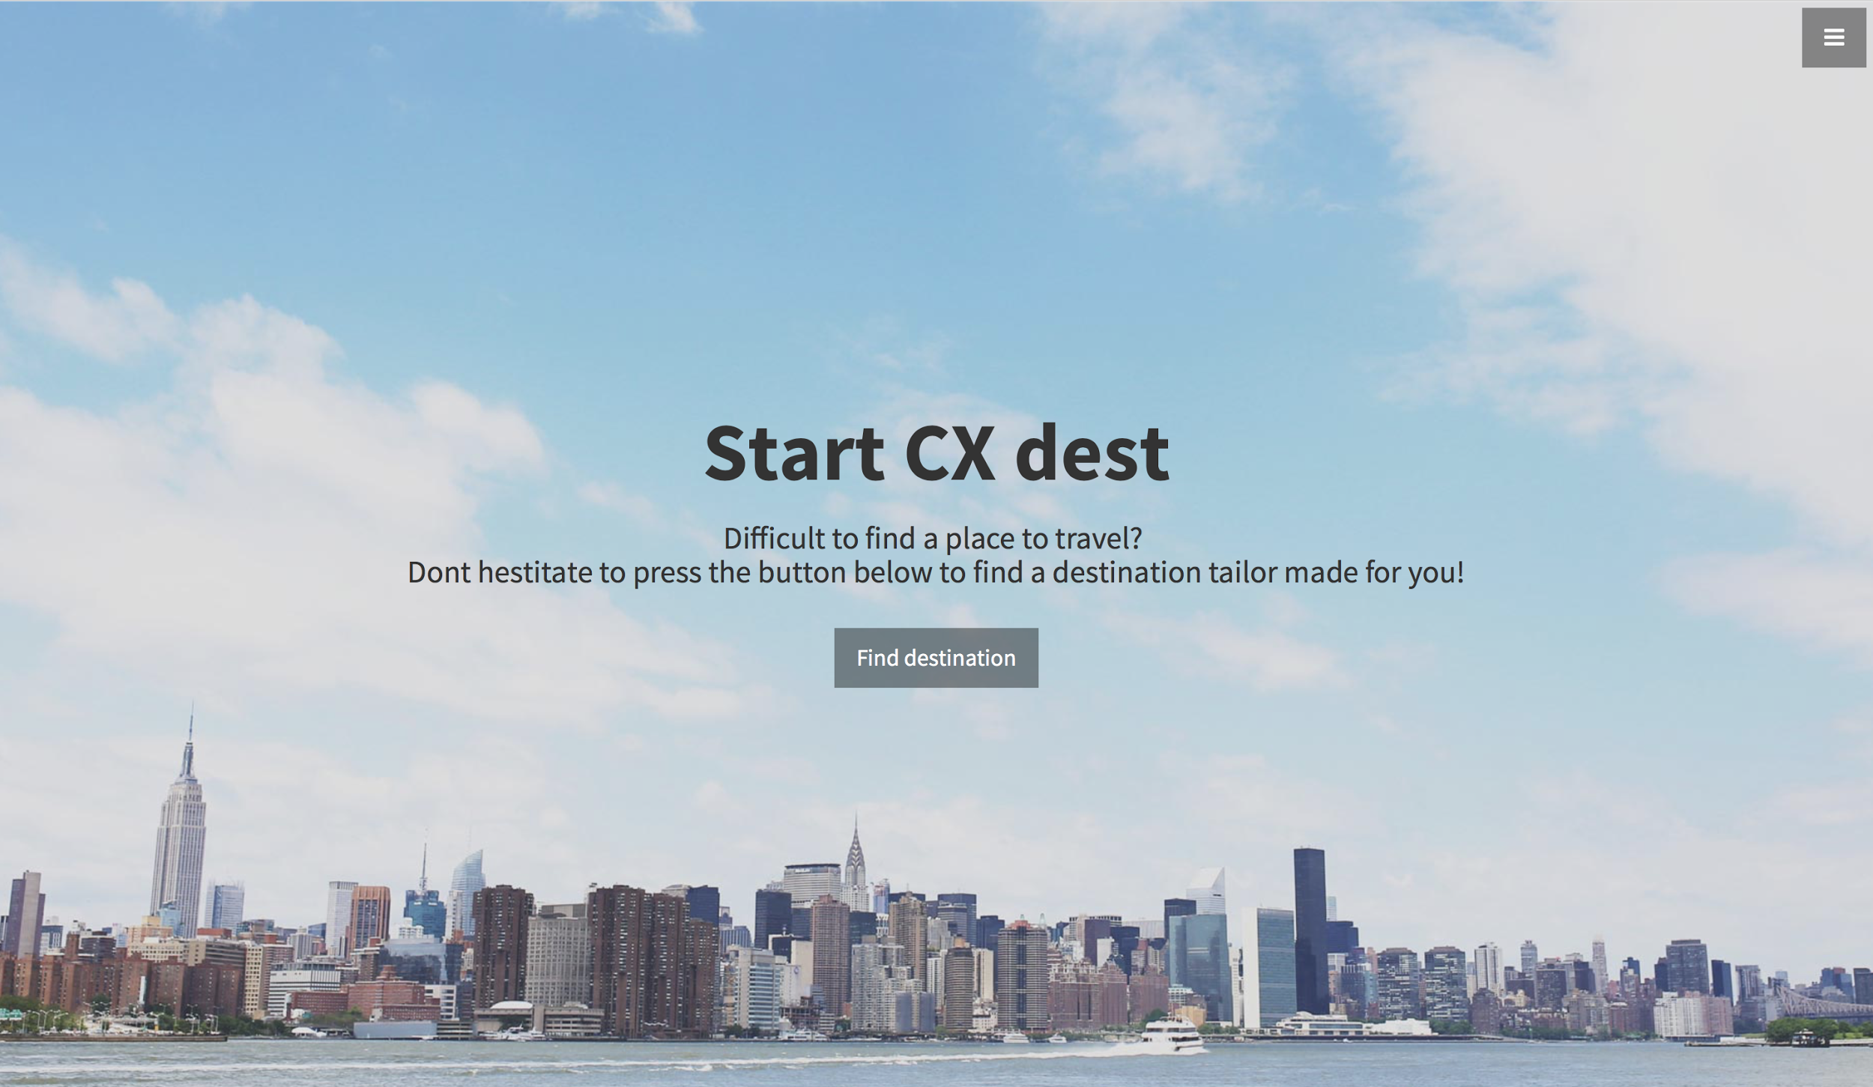

Slide 3
Objectives
Travelling become more and more popular
Hard to figure out a suitable destination out of various countries
Travellers have sets of criteria in mind
Criteria → list of destination suggestions

Slide 4
Functions
By Seasons, Festivals, Activities and Budget
Seasons: Spring, Summer, Autumn and Winter
Activities: Museum, Beach, Shopping, Ski and snow, Diving and Historical visit
Return: suggested cities which match criteria

Slide 5
Implementation
Front end: HTML, CSS, Bootstrap layout
Back end: Javascripts and JQuery

Slide 6
Demonstration

Slide 7
Q & A

